Slide 1


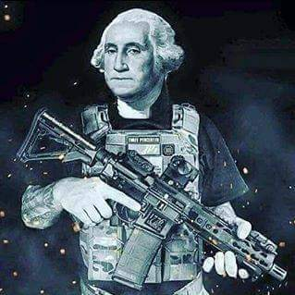

 | Renton Fish & Game Club Bay 3 Stage: Hell Yes, We’re Going To Take Your PCCs! Course Designer: Kris Erickson
SCENARIO: In the near dystopian future, President O'Rourke's flack vested gun buyback brigade has come knocking at your door. Boogaloo time!
START POSITION: Standing squarely facing door. Handgun loaded and holstered, wrists below belt. PCC loaded, stock on belt, muzzle pointed downrange. |  | STRINGS: 1 SCORING: Unlimited SCORED HITS: Best 2 ROUND COUNT: 12 TARGETS: 12 IDPA, 4 NT START-STOP: Audible - Last shot CONCEALMENT: Required Muzzle Safe Points: 180 degree rule SO NOTES:
STAGE PROCEDURE: At start signal, open door and retreat to the cover of P1. From available cover positions, engage available targets with at least 1 round. NOTES:
T8
T10
T4
T3
T9
T11
T6
T12
T5
T7
T1
T2
P2
P1
START
https://www.youtube.com/watch?v=7vEnTjs2RV0

